Slide 1
Chapter Four
Choice
选择

Slide 2
Structure
Rational constrained choice
Computing ordinary demands
  Interior solution （内在解）
  Corner solution （角点解）
  “Kinky” solution
Example: Choosing taxes

Slide 3
Economic Rationality
The principal behavioral postulate is that a decision-maker chooses its most preferred alternative from those available to it.
The available choices constitute the choice set.
How is the most preferred bundle in the choice set located?

Slide 4
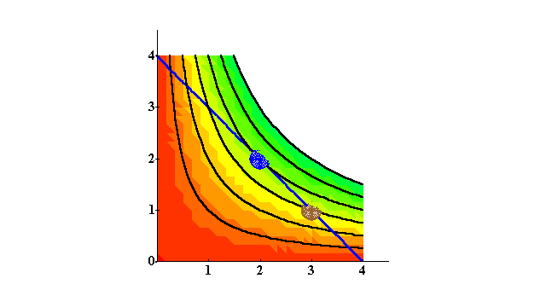
Rational Constrained Choice
x₂
More preferred
bundles
Affordable
bundles
x₁

Slide 5
Rational Constrained Choice
x₂
More preferred
bundles
Affordable
bundles
x₁

Slide 6
Rational Constrained Choice
x₂
x₂*
x₁*
x₁

Slide 7
Rational Constrained Choice
x₂
(x₁*,x₂*) is the most
preferred affordable
bundle.
x₂*
x₁*
x₁

Slide 8
Rational Constrained Choice
The most preferred affordable bundle is called the consumer’s ORDINARY DEMAND （一般需求）at the given prices and budget.
Ordinary demands will be denoted by
x₁*(p₁,p₂,m) and x₂*(p₁,p₂,m).

Slide 9
Rational Constrained Choice
When x₁* > 0 and x₂* > 0 the demanded bundle is INTERIOR.
If buying (x₁*,x₂*) costs $m then the budget is exhausted.

Slide 10
Rational Constrained Choice
x₂
(x₁*,x₂*) is interior.
(x₁*,x₂*) exhausts the
budget.
x₂*
x₁*
x₁

Slide 11
Rational Constrained Choice
x₂
(x₁*,x₂*) is interior.
(a) (x₁*,x₂*) exhausts the
budget; p₁x₁* + p₂x₂* = m.
x₂*
x₁*
x₁

Slide 12
Rational Constrained Choice
x₂
(x₁*,x₂*) is interior .
(b) The slope of the indiff.
curve at (x₁*,x₂*) equals
the slope of the budget
constraint.
x₂*
x₁*
x₁

Slide 13
Rational Constrained Choice
(x₁*,x₂*) satisfies two conditions:
(a) the budget is exhausted;
p₁x₁* + p₂x₂* = m
(b) tangency: the slope of the budget constraint, -p₁/p₂, and the slope of the indifference curve containing (x₁*,x₂*) are equal at (x₁*,x₂*).

Slide 14
Meaning of the Tangency Condition
Consumer’s marginal willingness to pay equals the market exchange rate.
Suppose at a consumption bundle (x₁, x₂),
  MRS=-2, -P₁/P₂=-1
  The consumer is willing to give up 2 unit of x₂ to exchange for an additional unit of x₁
  The market allows her to give up only 1 unit of x₂ to obtain an additional x₁
(x₁, x₂) is not optimal choice
She can be better off increasing her consumption of x₁.

Slide 15
x₂
x₁
x₁

Slide 16
Computing Ordinary Demands
Solve for 2 simultaneous equations.
  Tangency
  Budget constraint
The conditions may be obtained by using the Lagrangian multiplier method, i.e., constrained optimization in calculus.

Slide 17
Computing Ordinary Demands
How can this information be used to locate (x₁*,x₂*) for given p₁, p₂ and m?

Slide 18
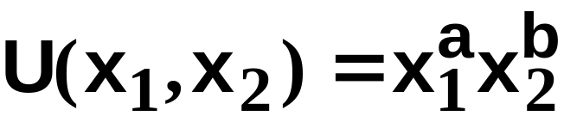
Computing Ordinary Demands - a Cobb-Douglas Example.
Suppose that the consumer has Cobb-Douglas preferences.

Slide 19
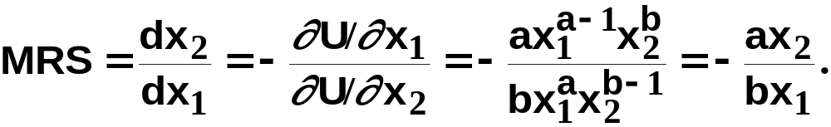
Computing Ordinary Demands - a Cobb-Douglas Example.
Suppose that the consumer has Cobb-Douglas preferences.
The MRS is

Slide 20
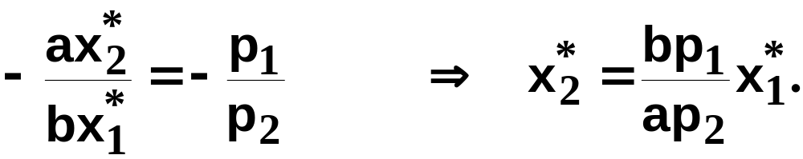
Computing Ordinary Demands - a Cobb-Douglas Example.
At (x₁*,x₂*), MRS = -p₁/p₂ so the tangency condition (MRS = -p₁/p₂) is
(A)

Slide 21
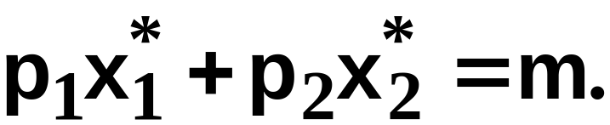
Computing Ordinary Demands - a Cobb-Douglas Example.
(x₁*,x₂*) also exhausts the budget so
(B)

Slide 22
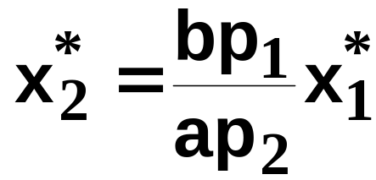

Computing Ordinary Demands - a Cobb-Douglas Example.
So now we know that
(A)
(B)

Slide 23
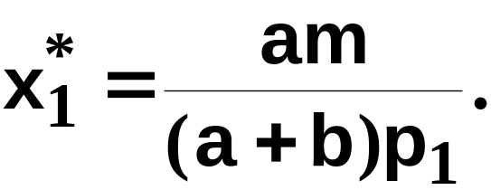
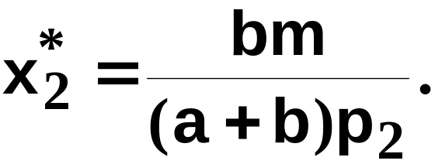
Computing Ordinary Demands - a Cobb-Douglas Example.
The solution to the simultaneous equations is:

Slide 24
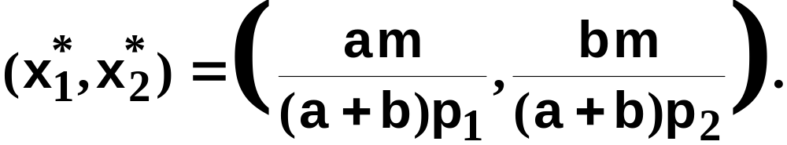
Computing Ordinary Demands - a Cobb-Douglas Example.
So we have discovered that the most
preferred affordable bundle for a consumer
with Cobb-Douglas preferences
is

Slide 25
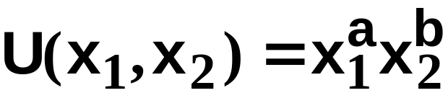
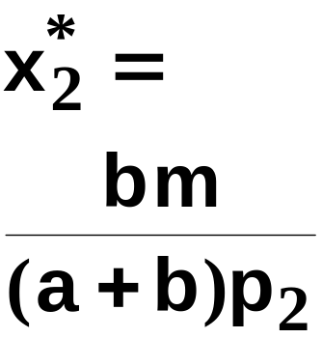
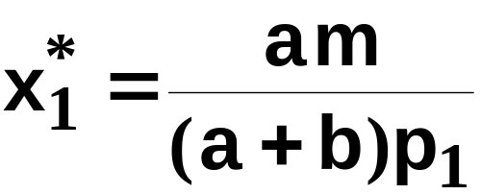
Computing Ordinary Demands - a Cobb-Douglas Example.
x₂
x₁

Slide 26
Rational Constrained Choice: Summary
When x₁* > 0 and x₂* > 0
and (x₁*,x₂*) exhausts the budget,
and indifference curves have no
‘kinks’, the ordinary demands are obtained by solving:
(a) p₁x₁* + p₂x₂* = y
(b) the slopes of the budget constraint, -p₁/p₂, and of the indifference curve containing (x₁*,x₂*) are equal at (x₁*,x₂*).

Slide 27
Rational Constrained Choice
But what if x₁* = 0?
Or if x₂* = 0?
If either x₁* = 0 or x₂* = 0 then the ordinary demand (x₁*,x₂*) is at a corner solution (角点解) to the problem of maximizing utility subject to a budget constraint.

Slide 28
Examples of Corner Solutions -- the Perfect Substitutes Case
x₂
MRS = -1
x₁

Slide 29
Examples of Corner Solutions -- the Perfect Substitutes Case
x₂
MRS = -1
Slope = -p₁/p₂ with p₁ > p₂.
x₁

Slide 30
Examples of Corner Solutions -- the Perfect Substitutes Case
x₂
MRS = -1
Slope = -p₁/p₂ with p₁ > p₂.
x₁

Slide 31
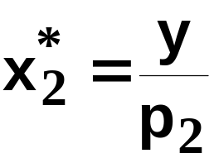
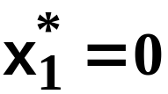
Examples of Corner Solutions -- the Perfect Substitutes Case
x₂
MRS = -1
Slope = -p₁/p₂ with p₁ > p₂.
x₁

Slide 32
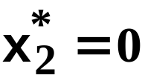
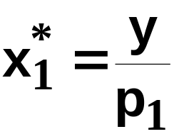
Examples of Corner Solutions -- the Perfect Substitutes Case
x₂
MRS = -1
Slope = -p₁/p₂ with p₁ < p₂.
x₁

Slide 33
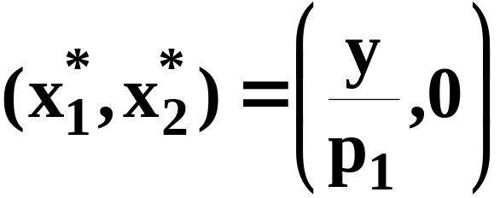
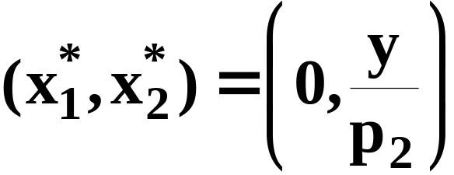
Examples of Corner Solutions -- the Perfect Substitutes Case
So when U(x₁,x₂) = x₁ + x₂, the most
preferred affordable bundle is (x₁*,x₂*)
where
if p₁ < p₂
and
if p₁ > p₂.

Slide 34


Examples of Corner Solutions -- the Perfect Substitutes Case
x₂
MRS = -1
Slope = -p₁/p₂ with p₁ = p₂.
x₁

Slide 35

Examples of Corner Solutions -- the Perfect Substitutes Case
x₂
All the bundles in the
constraint are equally the
most preferred affordable
when p₁ = p₂.
x₁

Slide 36
Examples of Corner Solutions -- the Non-Convex Preferences Case
x₂
Better
x₁

Slide 37
Examples of Corner Solutions -- the Non-Convex Preferences Case
x₂
x₁

Slide 38
Examples of Corner Solutions -- the Non-Convex Preferences Case
x₂
Which is the most preferred
affordable bundle?
x₁

Slide 39
Examples of Corner Solutions -- the Non-Convex Preferences Case
x₂
The most preferred
affordable bundle
x₁

Slide 40
Examples of Corner Solutions -- the Non-Convex Preferences Case
Notice that the “tangency solution”
is not the most preferred affordable
bundle.
x₂
The most preferred
affordable bundle
x₁

Slide 41
Examples of ‘Kinky’ Solutions -- the Perfect Complements Case
x₂
U(x₁,x₂) = min{ax₁,x₂}
x₂ = ax₁
x₁

Slide 42
Examples of ‘Kinky’ Solutions -- the Perfect Complements Case
x₂
U(x₁,x₂) = min{ax₁,x₂}
x₂ = ax₁
MRS = 0
x₁

Slide 43
Examples of ‘Kinky’ Solutions -- the Perfect Complements Case
x₂
U(x₁,x₂) = min{ax₁,x₂}
MRS = -
∞
x₂ = ax₁
MRS = 0
x₁

Slide 44
Examples of ‘Kinky’ Solutions -- the Perfect Complements Case
x₂
U(x₁,x₂) = min{ax₁,x₂}
MRS = -
∞
MRS is undefined
x₂ = ax₁
MRS = 0
x₁

Slide 45
Examples of ‘Kinky’ Solutions -- the Perfect Complements Case
x₂
U(x₁,x₂) = min{ax₁,x₂}
x₂ = ax₁
x₁

Slide 46
Examples of ‘Kinky’ Solutions -- the Perfect Complements Case
x₂
U(x₁,x₂) = min{ax₁,x₂}
Which is the most
preferred affordable bundle?
x₂ = ax₁
x₁

Slide 47
Examples of ‘Kinky’ Solutions -- the Perfect Complements Case
x₂
U(x₁,x₂) = min{ax₁,x₂}
The most preferred
affordable bundle
x₂ = ax₁
x₁

Slide 48
Examples of ‘Kinky’ Solutions -- the Perfect Complements Case
x₂
U(x₁,x₂) = min{ax₁,x₂}
x₂ = ax₁
x₂*
x₁*
x₁

Slide 49
Examples of ‘Kinky’ Solutions -- the Perfect Complements Case
x₂
U(x₁,x₂) = min{ax₁,x₂}
(a) p₁x₁* + p₂x₂* = m
x₂ = ax₁
x₂*
x₁*
x₁

Slide 50
Examples of ‘Kinky’ Solutions -- the Perfect Complements Case
x₂
U(x₁,x₂) = min{ax₁,x₂}
(a) p₁x₁* + p₂x₂* = m
(b) x₂* = ax₁*
x₂ = ax₁
x₂*
x₁*
x₁

Slide 51
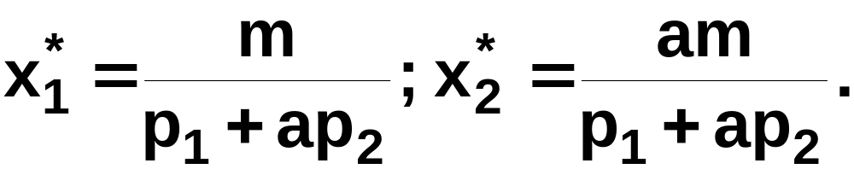
Examples of ‘Kinky’ Solutions -- the Perfect Complements Case
(a) p₁x₁* + p₂x₂* = m; (b) x₂* = ax₁*.
Substitution from (b) for x₂* in (a) gives p₁x₁* + p₂ax₁* = m
which gives

Slide 52
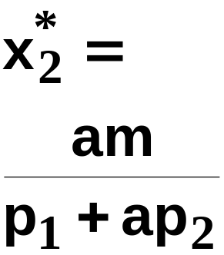
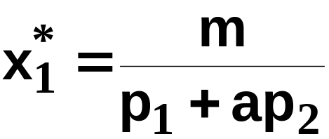
Examples of ‘Kinky’ Solutions -- the Perfect Complements Case
x₂
U(x₁,x₂) = min{ax₁,x₂}
x₂ = ax₁
x₁

Slide 53
Choosing Taxes: Various Taxes
Quantity tax: on x: (p+t)x
Value tax: on px: (1+t)px
  Also called ad valorem tax
Lump sum tax: T
Income tax:
  Can be proportional or lump sum

Slide 54
Income Tax vs. Quantity Tax
Original budget: p₁x₁ + p₂x₂ = m
After quantity tax:
  (p₁+t)x₁ + p₂x₂ = m
At optimal choice (x₁*, x₂*)
  (p₁+t)x₁* + p₂x₂* = m (5.2)
  Tax revenue: R*=tx₁*
With an income tax, budget is:
p₁x₁ + p₂x₂ = m- tx₁*

Slide 55
Income vs. Quantity Tax
Proposition: (x₁*, x₂*) is affordable under income tax
Equivalent to: prove that (x₁*, x₂*) satisfies budget constraint under income tax.
Or, budget constraint holds at point (x₁*, x₂*).
p₁x₁* + p₂x₂*= m- tx₁*
Which is true according to (5.2).
It is not an optimal choice because prices are different.
Conclusion: The optimal choice must be more preferred to (x₁*, x₂*)

Slide 56
